Slide 1
Overview of VEEVA Admin Console
LEVEL - PRACTITIONER

Slide 2
Recap ...
In the previous Module – Introduction to VEEVA, you learnt to ...
  Define VEEVA Systems
  Explore VEEVA CRM Architecture & VEEVA product suites
  Identify CRM language interface compatibility
  Choose supported platforms for VEEVA CRM
  Identify Product upgrade and New feature releases
And now ...

Slide 3

Do You Know
Admins can meet most of the business requirements with out of the box VEEVA functionality
VEEVA admin must configure VEEVA CRM application from online first and then, synchronize offline using VMOC

Slide 4

Objectives
After completing this chapter, you will learn to:
  Define typical VEEVA Administrator responsibilities
  Visualize VEEVA CRM interface - look & feel
  Access the main areas of Admin Console
  Work with Identity configuration in VEEVA
  Manage Company Information

Slide 5

Overview
VEEVA CRM, built-on SalesForce.com platform, is a customer relationship management product offering that is specialized for the Life Sciences industry
In this module, we will see how VEEVA Administrators can manage and maintain the application (esp. metadata) using the declarative features of Salesforce.com

Slide 6
Overview of VEEVA Admin Console
VEEVA Admin Responsibilities

Slide 7
VEEVA Admin Responsibilities
VEEVA Admin responsibilities are broadly classified into the following:
Gather, capture and document the Requirements of VEEVA Application
Configure the application based on the requirements
Set up & manage - users, licenses, profiles, roles, territory hierarchy etc.
Import (set up) and maintain business data and functionality access in VEEVA
Territory Alignment for Accounts
Deploy and seed data to and from offline platforms like iRep & Windows 10

Slide 8
Overview of VEEVA Admin Console
VEEVA CRM Interface & Administration Console Overview

Slide 9
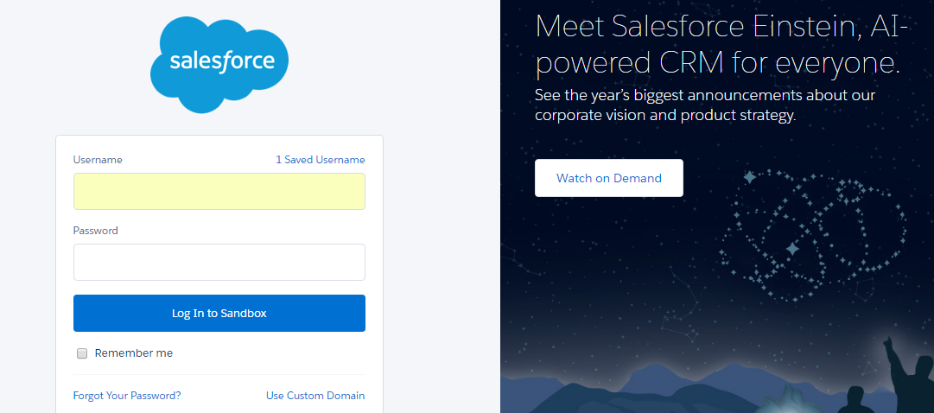
VEEVA CRM Interface
VEEVA application - Login:
Similar to Salesforce.com, VEEVA CRM can be accessed from Production and Sandbox environments. Standard login URL formats apply
  https://login.salesforce.com – Production
  https://test.salesforce.com – Sandbox

Slide 10
Access the Setup Console
You must login as an VEEVA admin to configure VEEVA CRM application
All Metadata configuration is done through VEEVA CRM online application Setup Console
  Navigation: Login to VEEVA CRM as Administrator > Admin User > Setup
Admin Console has Three Main Components, namely:
  Personal Setup: Set up Personal Information, Email, Import, Desktop Settings etc.
  App Setup: Manage Standard & Custom Objects (fields, page layouts, others), Apex classes, VF components, Deployment options, etc.
  Administration Setup: Manage users, apps, territories, company profile, Data Management, etc.

Slide 11
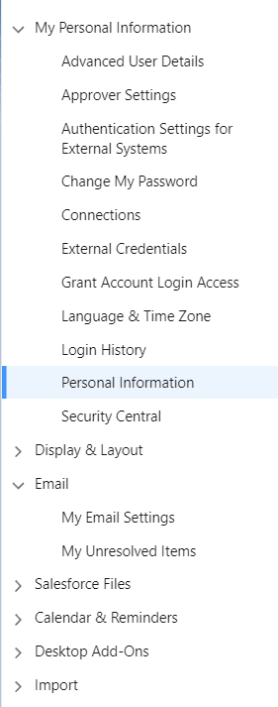
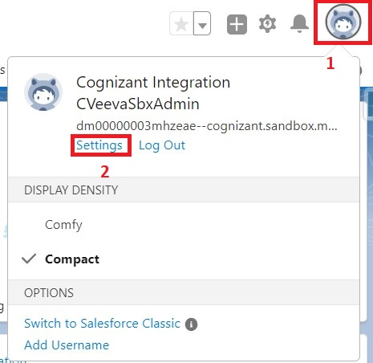
Setup Console – Personal Setup
Personal setup and customization options to help users personalize the application:
  This is the only setup menu accessible to end users
End users need to be trained to access the following major information:
  Personal Information
  Change Password
  Grant Login Access
  Email Settings

Slide 12
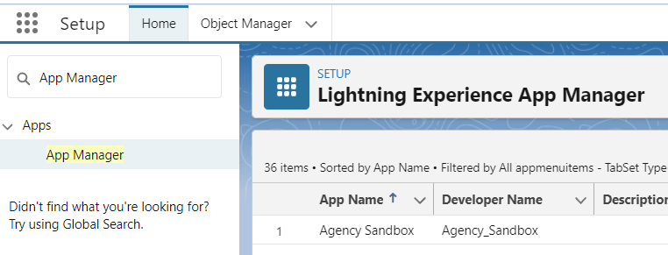
Setup Console – App Setup
App Setup area provides options to customize, create, develop, deploy and manage VEEVA (Salesforce.com) CRM, apart from the below mentioned options
  Lightning App Builder: Provides easy to use graphical interface for creating custom Lightning Pages for Salesforce Lightning Experience and mobile app
  Canvas App Builder: Provides preview of Canvas apps before publishing them

Slide 13
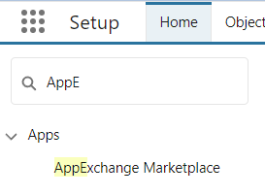
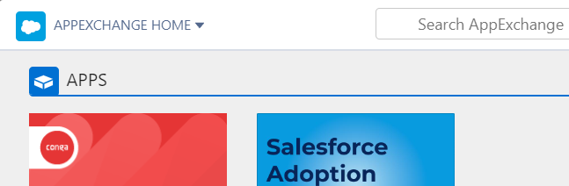
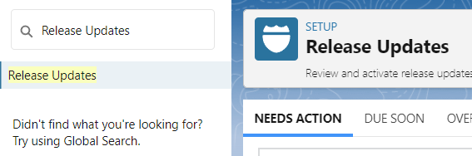
Setup Console – App Setup
  Installed Packages: View and manage packages installed from AppExchange
  AppExchange Marketplace: App Store for Salesforce.com
  Critical Updates: Admin can control critical updates enablement for the organization

Slide 14
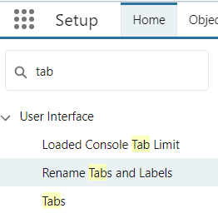
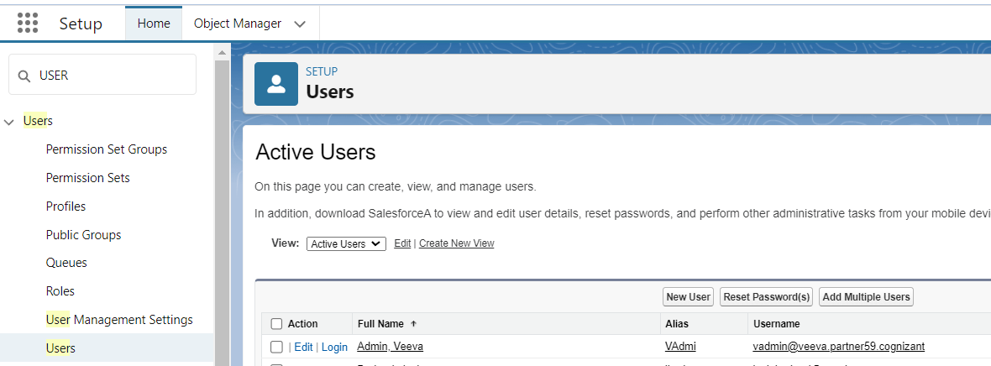
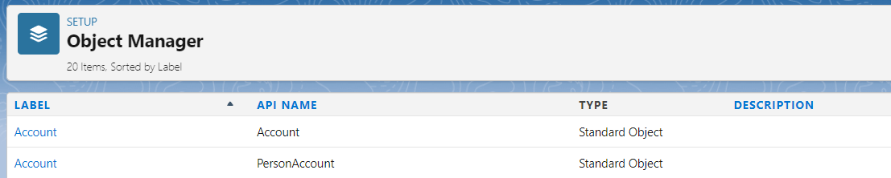
App Setup - Customize
Customize under App Setup
Although all Salesforce objects are available in Admin Console (under App Setup > Customize), only few standard objects are used by VEEVA and should be configured further
  Tab Names and Labels, Home, Activities
  Accounts, Contacts
  Users
  Reports & Dashboards, Search, Chatter, EMAIL (User Interface)

Slide 15
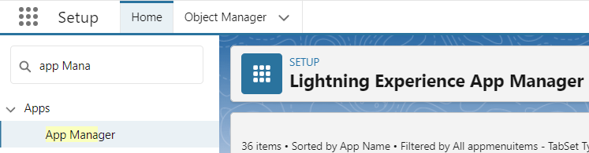
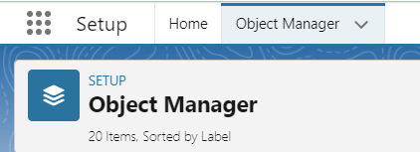
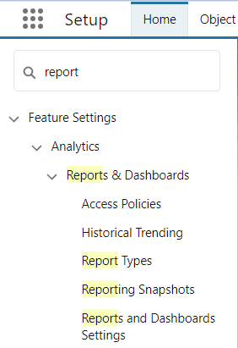
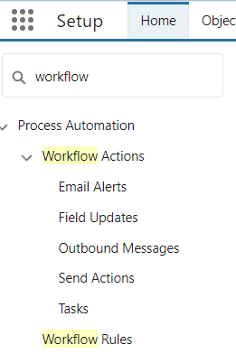
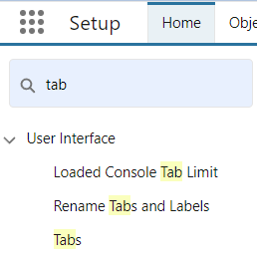
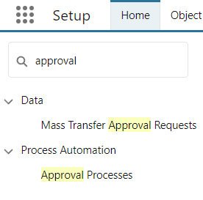
App Setup - Create
Create under App Setup
This area provides point-and-click tool to configure the VEEVA CRM application
  Admin does not require any coding skill for this configuration
VEEVA is a custom Salesforce application and provides many components out-of-the-box including the following:
  Applications: Manage custom apps
  Objects: Pharma specific metadata and business logic
  Report Types: Set of objects to create custom report
  Tabs: Manage custom object and visual force tabs
  Workflow and Approvals: Create automated business processes that send email alerts, assign tasks, update fields

Slide 16
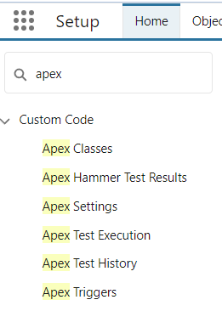
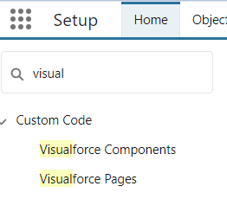
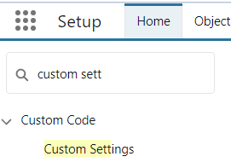
App Setup – Develop 1
Develop under App Setup
This development menu contains components which implement VEEVA out of box application logic-
  Apex Class
  Apex Trigger
  Visualforce Page
  Custom Settings
Use customization only if the requirement cannot be met by using out of the box VEEVA functionalities or by any kind of configuration

Slide 17
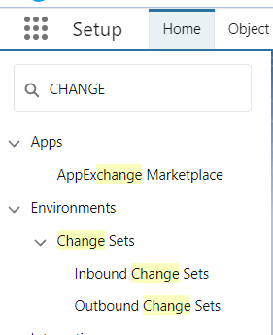
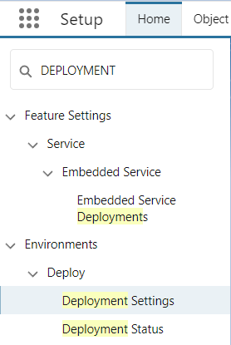
App Setup - Deploy
Deploy under App Setup
This area provides tools to migrate metadata between environments:
    Production environment
    Sandbox associated with same production
Change Set
    Collection of changes made in one org (Sandbox) and packaged to migrate to another related org (Production or other related Sandbox)

Slide 18
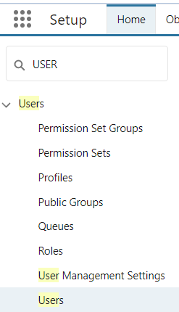
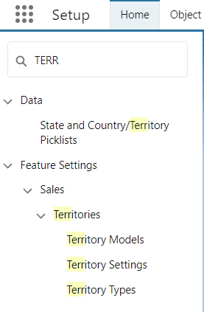
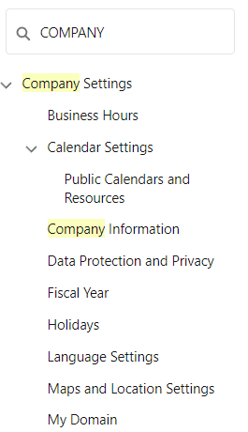
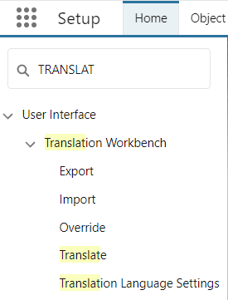
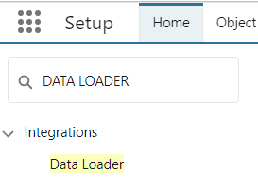
Setup Console – Administration Setup
This area provides utilities to manipulate data in the application
Primary focus areas for VEEVA CRM admin are:
  Manage Users: Manage user details, Configure Role, Profile and Permission Set
  Manage Territories: Territory hierarchy should be same as role hierarchy
  Company Profile: Manage organization details
  Translation Workbench: Provide translation for other languages Salesforce and VEEVA supports
  Data Management: Data loader and Sandboxes

Slide 19
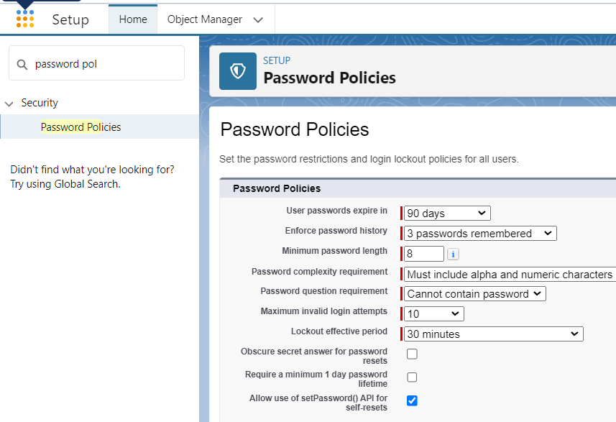
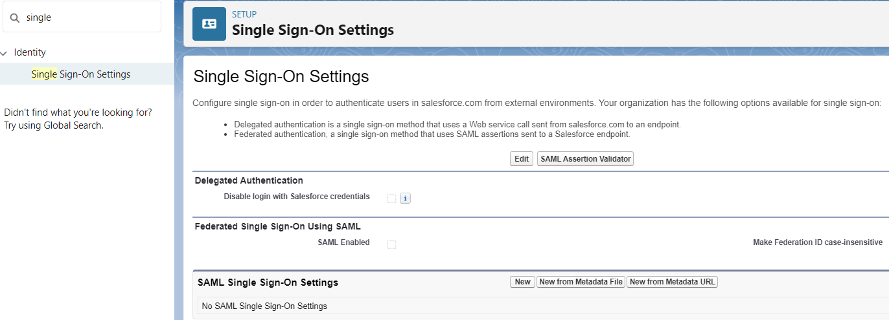
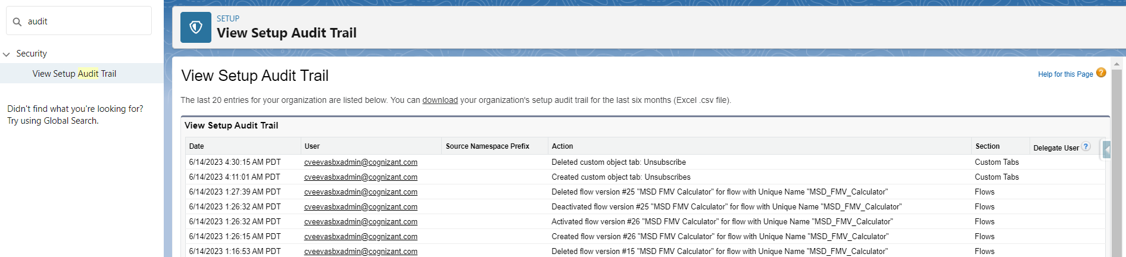
Setup Console – Administration Setup
This area provides utilities to manipulate data in the application
Primary focus areas for VEEVA CRM admin are:
  Security Controls: Sharing and Security, Password policy, SSO, Audit Trail

Slide 20
Overview of VEEVA Admin Console
Identity Configuration in VEEVA

Slide 21
Identity Configuration
Data security is of primary importance in VEEVA CRM
VEEVA Admins, majority of the times, use Trusted IP ranges in addition to user login credentials as an extra layer of security
Admins can use either of the following options:
  White-list the IP ranges for the Org
  OR
  White-list all IP ranges to turn off IP Authentication for the Org by deploying a package available at - https://login.salesforce.com/packaging/installPackage.apexp?p0=04tF0000000JHh6

Slide 22
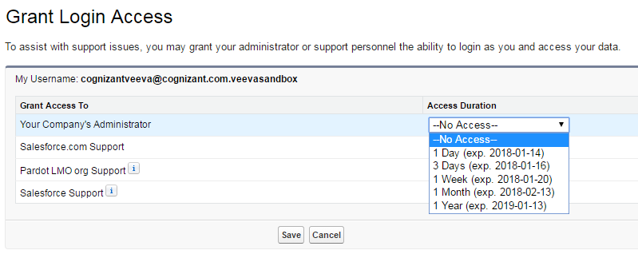
Grant Administrators Login Access
Granting login access to VEEVA admin provides the ability for admin to login as an end user
  This is applicable only for online application
  This helps admin to monitor and troubleshoot
Users need to follow below steps to provide login access
  Navigate: Setup > My Personal Settings> Grant Login Access
  Set Access Duration to a future date

Slide 23
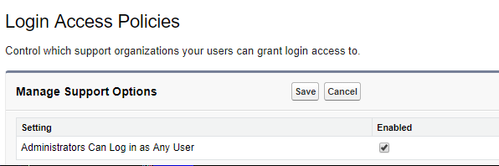
Default Administrator Login Access
Admins can login as any user in her/his Org. without asking for login access
  When enabled, users will not have the option to grant or revoke login access to administrators
Steps to follow to enable this login access policy:
  Create a Salesforce.com case to enable this feature
  Then, as Administrator, go to Setup > Security Controls > Login Access Policies
  On the Login Access Policies page, set flag ‘Admin can log as any user’ to Yes
  Click Save

Slide 24
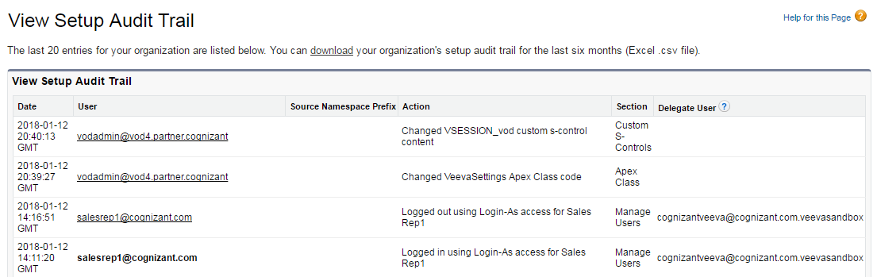
Login History Audit Trail
VEEVA Admins often utilize out of box Audit Trail feature of Salesforce to enforce security
  Steps to visit Audit trail: Setup > > Security Controls > View Setup Audit trail
The audit trail shows the following:
  The configuration or customization changes done by admin
  When the admin logs in and out as a user

Slide 25
Overview of VEEVA Admin Console
Company Information Overview

Slide 26
Company Information Overview
Information provided about the company to VEEVA during purchase appears in Company Information
Admin can manage the following for an Org:
  Primary Contact
  Default Language, Locale and time Zone
  Organization IF- needed to log cases with Salesforce
  Manage user Licenses
  Setup Currencies
  Fiscal Year Definition
  Company Holidays: really helpful for small support staff group within the Org

Slide 27
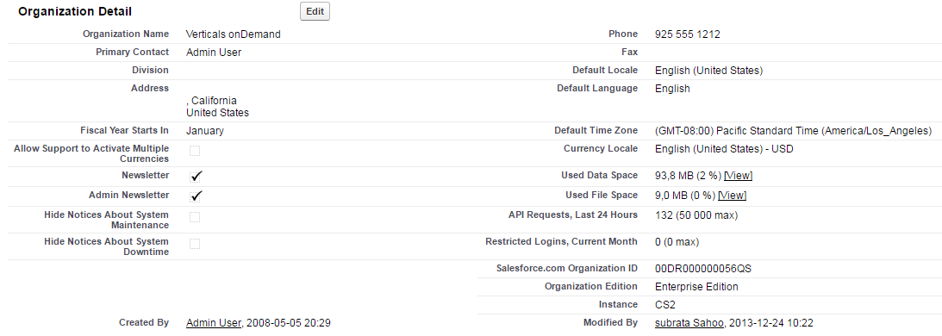
Managing Company Information
VEEVA Admin can manage Company Settings via:
  Setup > Company Profile > Company Information
Admins can also manage License information from this location
  Salesforce – Administrator Licenses: Normally, couple of licenses for Admins and system integration user id are required
  Salesforce Platform – VEEVA Licenses: Each active VEEVA User (for e.g. Sales Rep, Sales Manager, KAM) use Salesforce Platform Licenses

Slide 28
Managing Company Information
VEEVA Admin can manage Company Settings via:
  Setup > Company Profile > Company Information
Admins can also manage License information from this location
  Salesforce – Administrator Licenses: Normally, couple of licenses for Admins and system integration user id are required
  Salesforce Platform – VEEVA Licenses: Each active VEEVA User (for e.g. Sales Rep, Sales Manager, KAM) use Salesforce Platform Licenses

Slide 29
Best Practice
Admins can meet most of the business requirements with out of the box VEEVA functionality
If needed, Admins can define custom objects/fields/layout and/or switch on/off in-built functionality using VEEVA Settings
Readily achieve business automations through configuration tools like Validation Rules, Formulas, Workflows, Flow, Process Builder and Approval Processes
Use customization only if the requirement cannot be met by using out of the box VEEVA functionalities or by any kind of configuration
Involve a developer to create visual force Pages, Triggers and Apex Classes
Contact VEEVA prior to modifying VEEVA S-Controls

Slide 30
Check Your Understanding ... 1
What should an admin do first to implement any requirement?
Configure VEEVA CRM application from online
Synchronized offline using VMOC Org Wide Default
Answer: Configure VEEVA CRM application from online

Slide 31
Check Your Understanding ... 2
Select the objects that are used and configured by VEEVA
Accounts
Contacts
Agent Console
Scorecards
Tab Names and Labels
Answer: Accounts, Contacts, Tab Names and Labels

Slide 32
Check Your Understanding ... 1
Identify the menu item/items that is/are accessible to end users
App Set up
Personal Set up
Both
Answer: Personal Set up

Slide 33
Check Your Understanding ... 1
Login access is granted to VEEVA admin to enable to login as an end user. Which of the following statement holds good regarding the same?
This is applicable for online and offline modes
Users will have the option to grant or revoke login access to administrators
Access duration can be future dated
This option has to be selected in the Setup -> Security Controls > Login Access Policies
Answer: Access duration can be future dated
This option has to be selected in the Setup -> Security Controls > Login
Access Policies

Slide 34
Check Your Understanding ... 1
Administrator Licenses are sufficient to manage the license information
TRUE
FALSE
Answer: FALSE.
Salesforce Platform - VEEVA licenses are required for each active
VEEVA user

Slide 35

Summary
In this module, you have learnt to:
Define the typical VEEVA Admin’s responsibilities
Log in to VEEVA interface
Identify the main areas of Admin Console
Define and demonstrate Identity Configuration
Describe how to manage Company Information

Slide 36
Coming Next ...
In the upcoming module – Data Access And Security you will learn to,
Define Salesforce.com Data Access Security
Describe mechanisms for securing data access:
  Profiles
  Permission Sets
  FLS
  Record Ownership
  OWD
  Role Hierarchy
  Territory Hierarchy
  Sharing rules
  Manual sharing
Create and Manage User Accounts

